Slide 1

RUNGTA COLLEGE OF DENTAL SCIENCES & RESEARCH
DISASTER MANAGEMENT (PART-2)
DEPARTMENT OF PUBLIC HEALTH DENTISTRY

Slide 2
Specific learning Objectives
At the end of this presentation the learner is expected to know ;
Sr.no | Learning objectives | Domain | Level | Criteria | condition
1. | Discuss various types of disaster | Cognitive | Nice to know | 02
2. | Describe the role of dentist in mass disaster | Cognitive | Nice to know | 04
3. | Various methods for dental identification | Cognitive | Desire to know | 02

Slide 3
CONTENTS
VARIOUS METHODS IN DENTAL IDENTIFICATION
SUMMARY

Slide 4
BODY TAGGING & BAGGING
First, the bodies are refrigerated both before and after the identification procedure.
The labelling of each body is done with identifying number, followed by bagging.

Slide 5
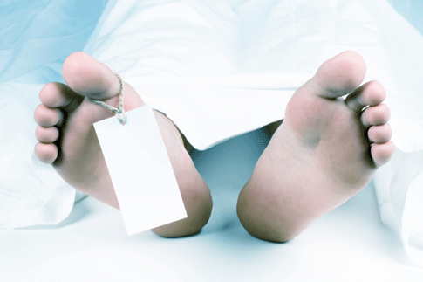
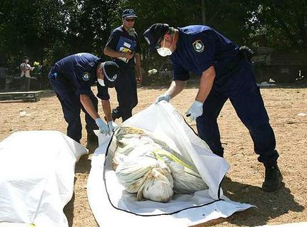
BOD BODY TAGGING
BODY BAGGING

Slide 6

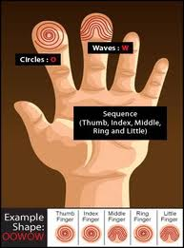
Finger Printing
Fingerprint identification {dactyloscopy}
Is the process of comparing two instances of friction ridge skin impressions from human fingers,
The palm of the hand or even toes.

Slide 7
Forensic Pathology
Forensic pathologists focus on the examination people.
These examinations include review of medical histories.
This work is assisted by a range of other medical experts.

Slide 8
Forensic Dentistry
Definition
“It is the proper handling, examination and evaluation of dental evidence, which will be then presented in the interest of justice”

Slide 9
Every human body ages in a similar manner,
The teeth also follow a semi-standardized pattern.
These quantitative measurements help establish relative age .
Each human has an individual set of teeth .
  W h y T e e t h ?

Slide 10
Teeth is made of enamel (hardest tissue of the body)
Teeth are a source of DNA: dental pulp.

Slide 11

M e t h o d s
Dental records
Rugaescopy
Chieloscopy
Dental treatment and restoration
Radiology
DNA
Carbon dating
Microchip
Denture labeling
Dental cast
Saliva Sampling
Skyce

Slide 12
DENTAL RECORDS
Compares AM and PM data
Dental patterns are unique in every person
Identification rates are highest where dental health care system is of high quality

Slide 13
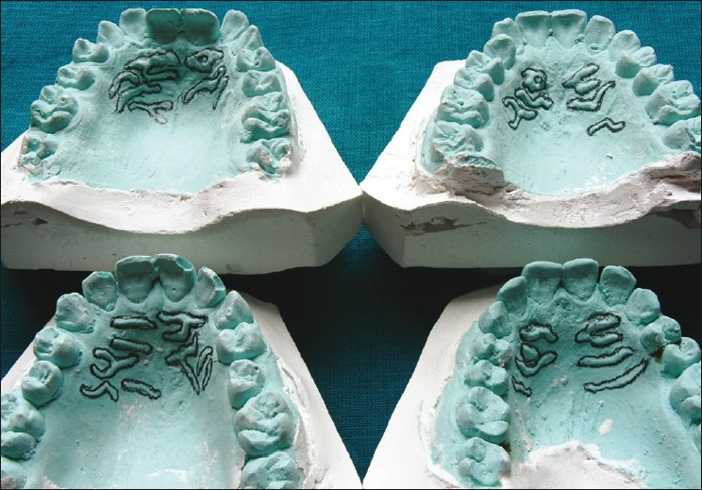
Rugaescopy
The shapes of individual rugae were classified into 4 major types:
a) Curvy
b) Wavy
c) Straight
d) Circular

Slide 14
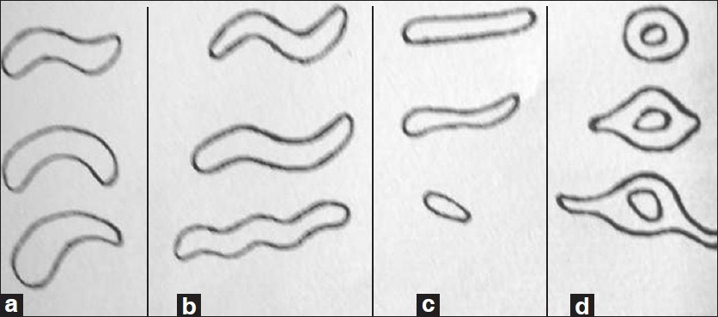
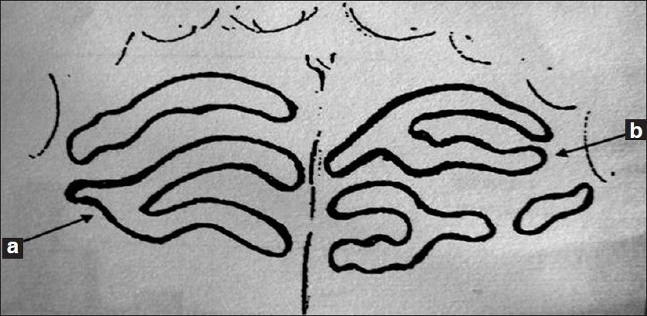
Curved Wavy Straight circular
Convergent Divergent

Slide 15
Chieloscopy
External surface of lip has elevation & depressions
It forms a characteristic pattern called lip patterns.
Examination of which is referred to as chieloscopy
This is unique for individual like the fingerprints.

Slide 16
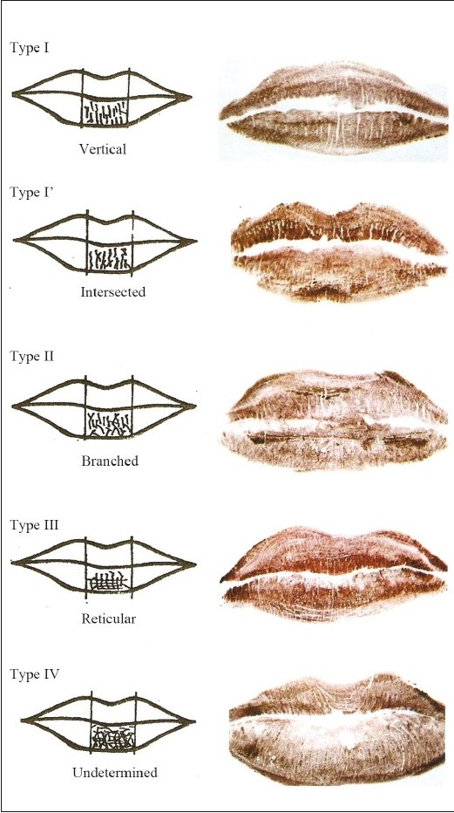
Types of lip prints
Suzuki’s Classification

Slide 17
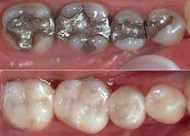
Dental Treatment and Restorations
1) Dental restoration
Outlines, slopes, presence of corrosion or wear of restoration helps in identification.
Root canal therapy can be compared with ante mortem radiographs.

Slide 18
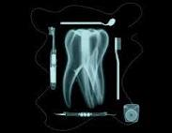
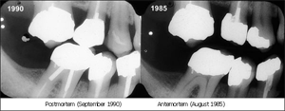
Intraoral radiograph
Comparison between ante mortem and postmortem radiograph.
To reveal hidden details.

Slide 19
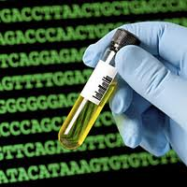
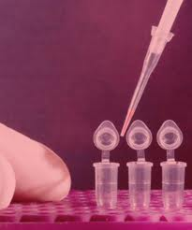
.
DNA analysis
1) Restriction fragment length polymorphisms(RFLPs).
2) Amplified fragment length polymorphisms(Amp-RFLPs).
3) Short tandem repeats(STRs).
4) Polymerase chain reaction(PCR).

Slide 20
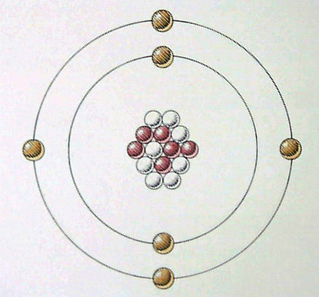
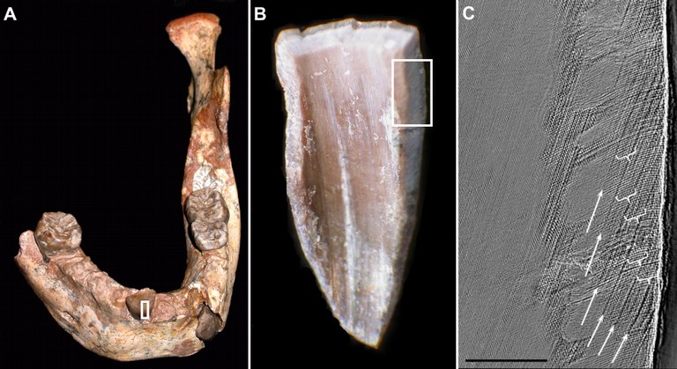
CARBON 14 DATING
Determines individuals age by estimating radio carbon 14 contents of enamel

Slide 21
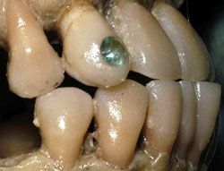
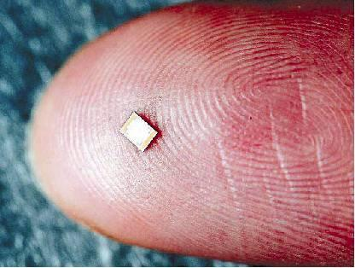
Microchip
(Swiss Technique)
Placing radio based tagging data storing
which detected by reading device and enables individuals identity

Slide 22
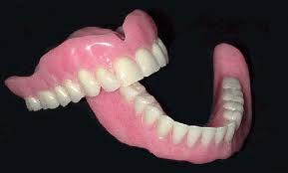
Denture marking
1857
1857
Various denture marking method have been used either by engraving or inclusion.
Engraving of the master cast before acrylization .
Inclusion of stainless steel or tin foils are used to leave a mark.

Slide 23
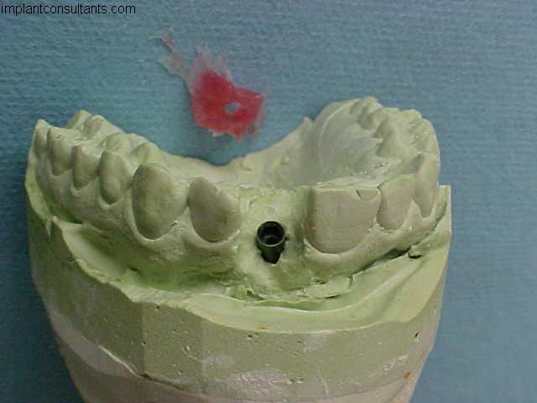
DENTAL CAST
Shows individual’s teeth shape and size
Single teeth with sufficient unique features can be used for identification

Slide 24
Organizations for disaster management in India
National Center for Disaster Management, New Delhi
National Information Center of Earthquake Engineering- IIT Kanpur, U.P.
Disaster Management Institute, Bhopal, M.P.
Disaster Mitigation Institute, Ahmedabad, Gujarat

Slide 25
SUMMARY
Forensic dentistry plays a major role in body identification
Worldwide agencies in the field of mass disaster
INDIA is lacking in this field
Need to implement various strategies regarding forensic dentistry

Slide 26
EXPECTED QUESTIONS
Describe the role of dentist in mass disaster (saq)
What are the various methods for disaster identification ( SAQ)

Slide 27
Bibliography
Textbook of Essentials of Preventive & Community Dentistry, by Soben Peter, 3rd Edition. Arya Publishers.
Community Dentistry, by Vimal Sikri,Poonam Sikri, 1st Edition,CBS Publishers.
Text book of Preventive & Social Medicine, by Gupta & Mahajan, 3rd Edition,Japee Publishers .
PARK’S Textbook of Prfeventive and Social Medicine ,by K. Park,17th Edition,Banarasidas Bhanot Publishers.
Textbook of Preventive and Community Dentistry,1st Edition, by S.S. Hiremath,Elsevier Publications.

Slide 28
THANK YOU

